Slide 2
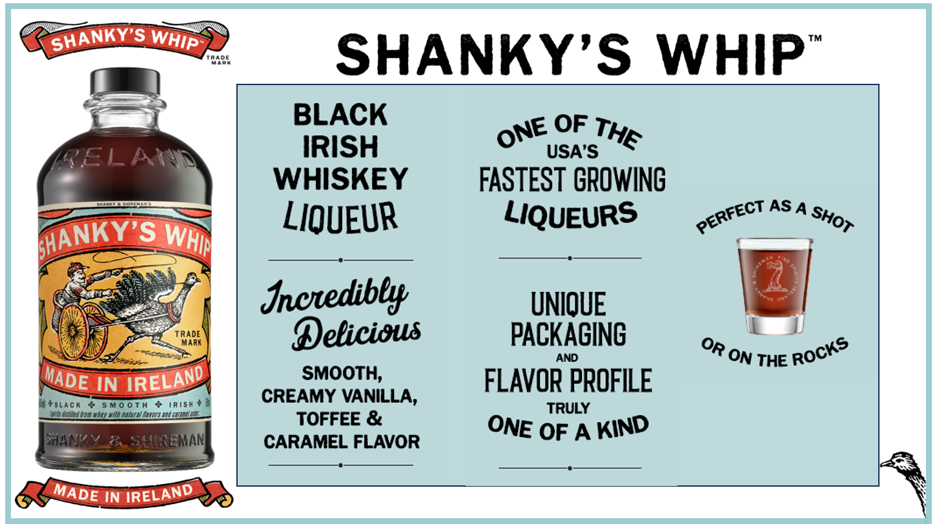

Slide 3
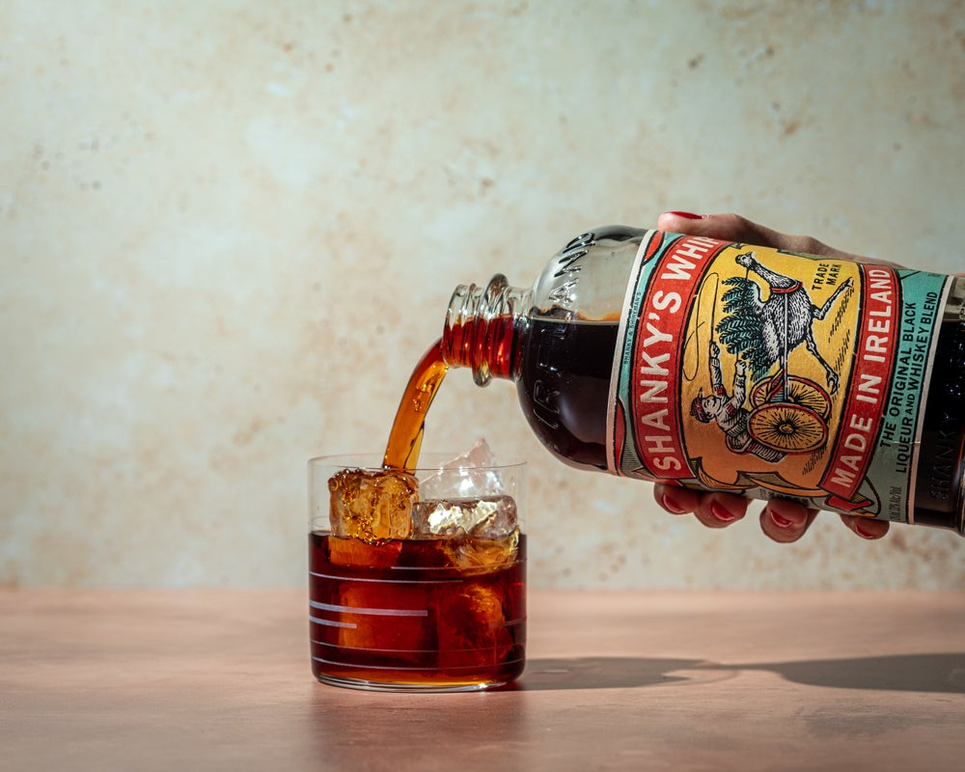
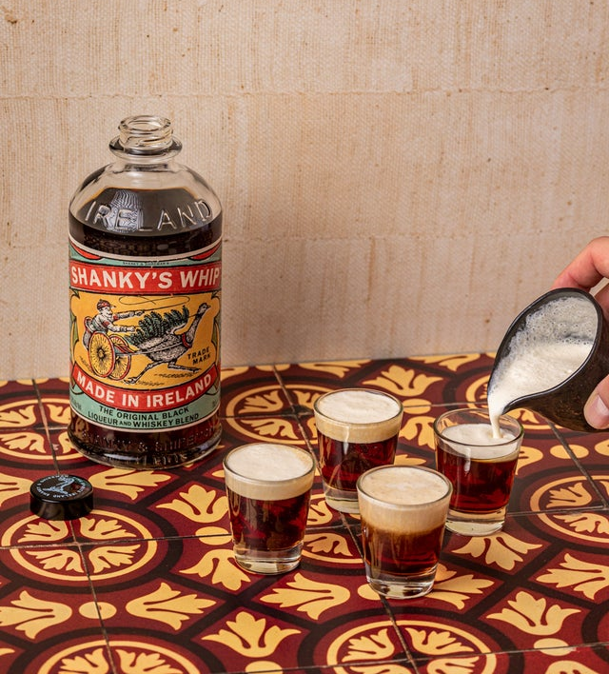
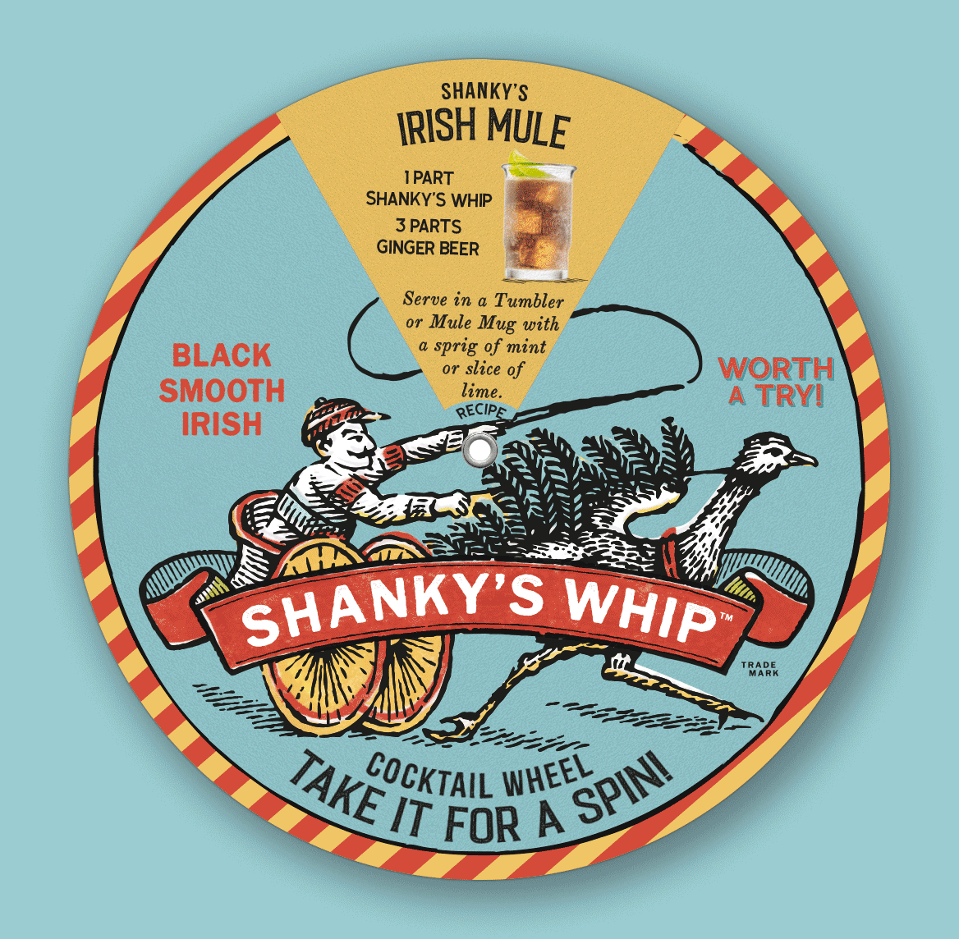
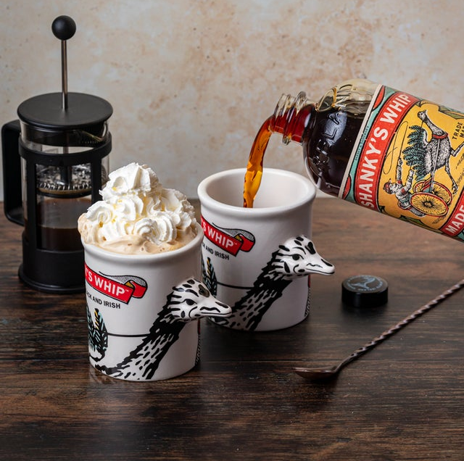
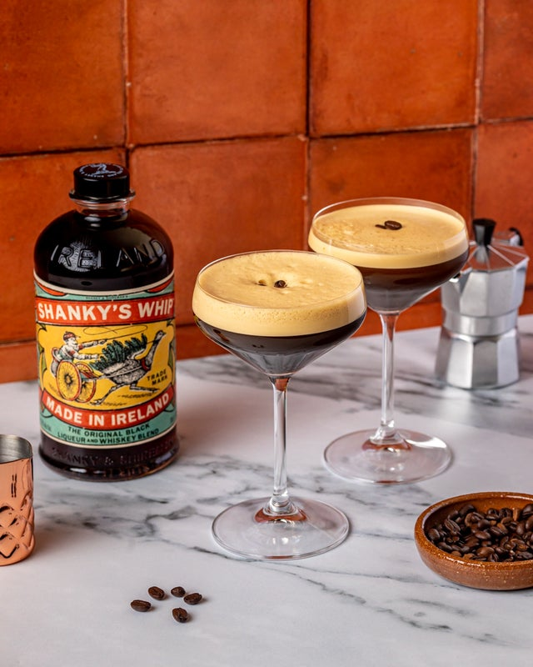
SHOTS, ROCKS, COLA, OLD FASHIONED, NEAT
ROOT BEER, STOUT BEER, GINGER BEER
COFFEE, ESPRESSO, CHOCOLATE MILK
…
PINEAPPLE JUICE, CRANBERRY JUICE, ICED TEA

Slide 9
